Slide 1
What is Internet Of Things(IoT)?
Internet of Things(IoT) is a network of physical objects or "things" that are embedded with software, electronics, network, and sensors that allows these objects to collect and exchange data.
The goal of IoT is to extend internet connectivity from standard devices like computer, mobile, tablet to relatively dumb devices like a toaster.
IoT makes virtually everything "smart," by improving aspects of our life with the power of data collection, AI algorithm, and networks.

Slide 2
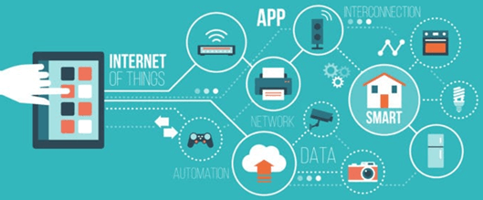

Slide 3
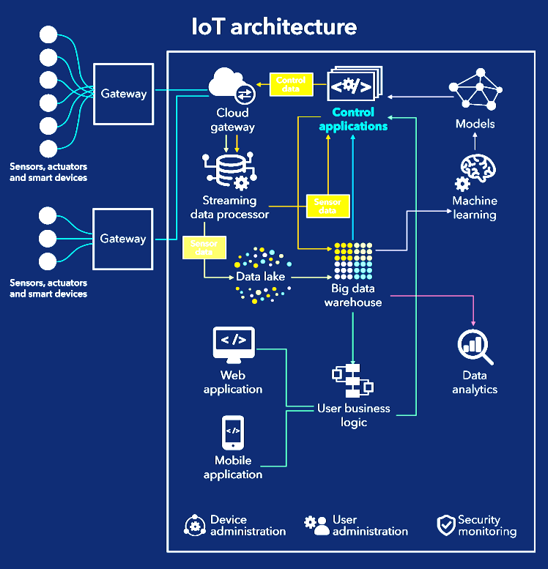

Slide 4

IOT Applications

Slide 5
TinkerCad
Introduce you to the basics of Tinkercad Circuits.
which was a free and easy to use breadboard simulator.
Like Fritzing, is a great design resource for makers.
Education for introducing students to electronics and coding in a virtual low-effort, low-risk and low-cost environment.
Even generate their actual Arduino code.
component library -
input, output, power, Breadboards,
Microcontrollers - Arduino Uno R3 and an ATtiny
Instruments - multimeter, a power supply, a function generator and an oscilloscope.
Integrated Circuits – such as timers, an op-amp and comparators

Slide 6
What Is Arduino?
Arduino is an open source programmable circuit board that can be integrated into a wide variety of makerspace projects both simple and complex.
This board contains a microcontroller which is able to be programmed to sense and control objects in the physical world. By responding to sensors and inputs, the Arduino is able to interact with a large array of outputs such as LEDs, motors and displays.
Because of it’s flexibility and low cost, Arduino has become a very popular choice for makers and makerspaces looking to create interactive hardware projects.

Slide 7
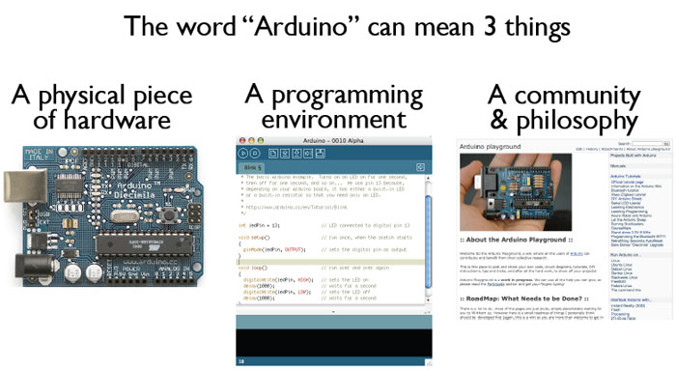
What is the Arduino
todbot.com/blog/bionicarduino

Slide 8
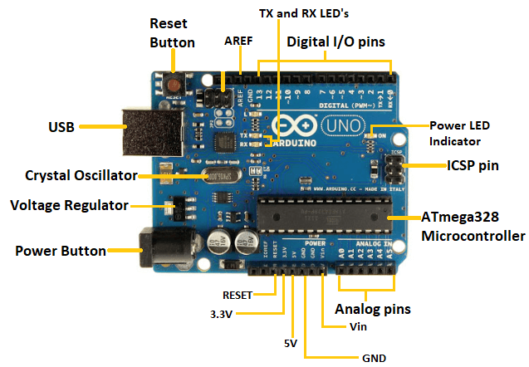
ATmega328 Microcontroller- is a single chip Microcontroller of the ATmel family. The processor code inside it is of 8-bit. It combines Memory (SRAM, EEPROM, and Flash), Analog to Digital Converter, SPI serial ports, I/O lines, registers, timer, external and internal interrupts, and oscillator.
ICSP pin - The In-Circuit Serial Programming pin allows the user to program using the firmware of the Arduino board.
Digital I/O pins- The digital pins D0 - D13 have the value HIGH or LOW.
Analog Pins- The pins A0 to A5 are analog pins.
AREF- The Analog Reference (AREF) pin is used to feed a reference voltage to the Arduino UNO board from the external power supply.
Crystal Oscillator- The Crystal oscillator has a frequency of 16MHz, which makes the Arduino UNO a powerful board.(OUTPUT STABLE FOR LONGER PERIOD)
Voltage Regulator- The voltage regulator converts the input voltage to 5V.
Arduino UNO

Slide 9
Getting Started
Check out: http://arduino.cc/en/Guide/HomePage
Download & install the Arduino environment (IDE)
Connect the board to your computer via the UBS cable
If needed, install the drivers (not needed in lab)
Launch the Arduino IDE
Select your board
Select your serial port
Open the blink example
Upload the program

Slide 10
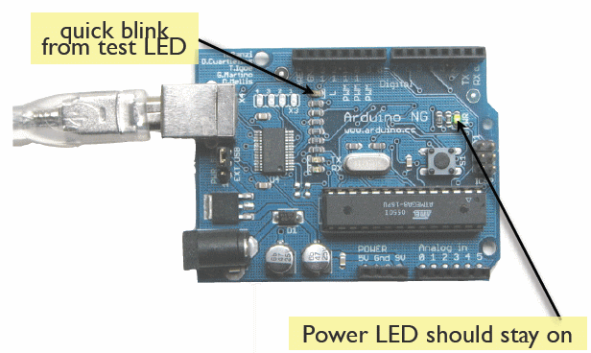
Try It: Connect the USB Cable
todbot.com/blog/bionicarduino

Slide 11
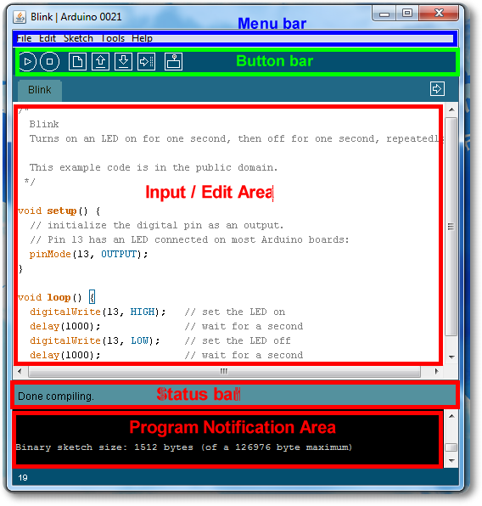
Arduino IDE
See: http://arduino.cc/en/Guide/Environment for more information

Slide 12
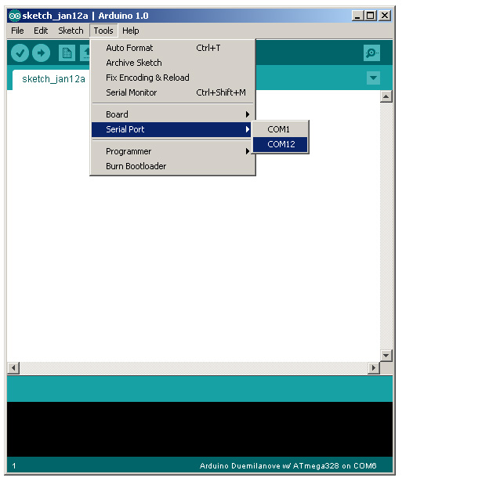
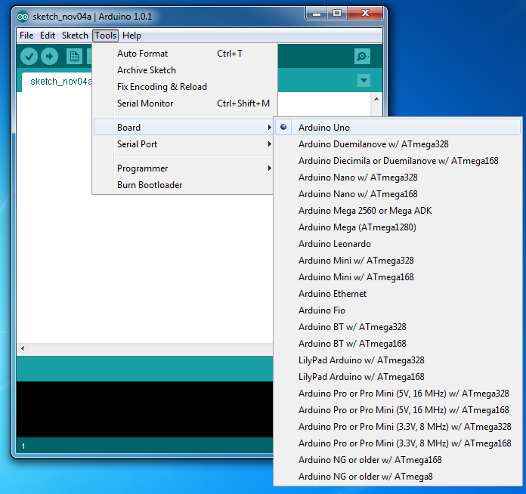
Select Serial Port and Board

Slide 13
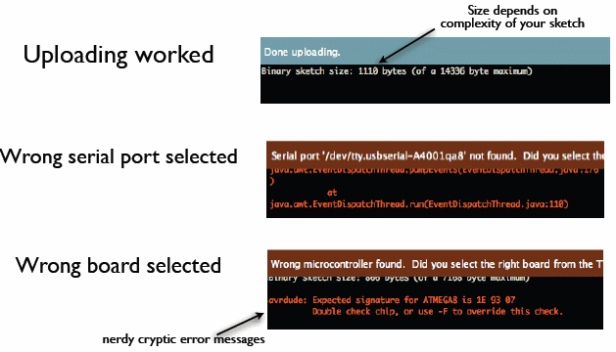
Status Messages
todbot.com/blog/bionicarduino

Slide 14
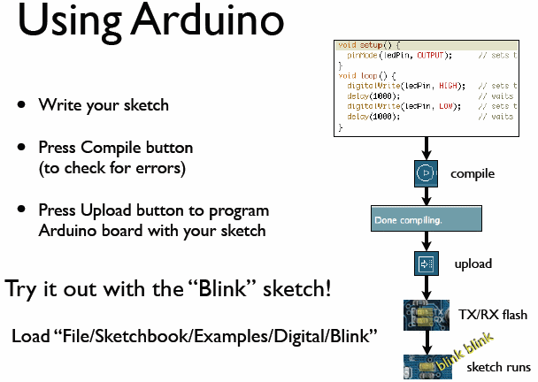
todbot.com/blog/bionicarduino

Slide 15
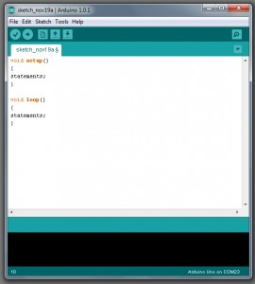
A Little Bit About Programming
Code is case sensitive
Statements are commands and must end with a semi-colon
Comments follow a // or begin with /* and end with */
loop and setup

Slide 16
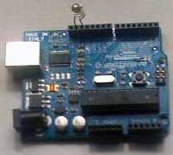
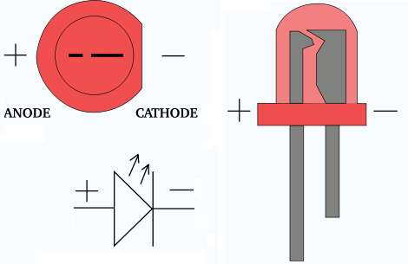
Add an External LED to pin 13
File > Examples > Digital > Blink
LED’s have polarity
Negative indicated by flat side of the housing and a short leg
www.instructables.com

Slide 17
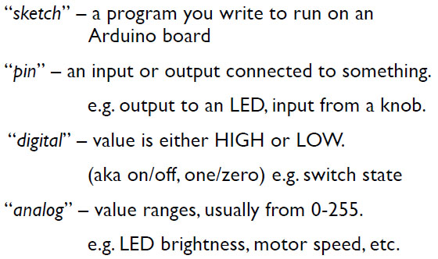
Terminology

Slide 18
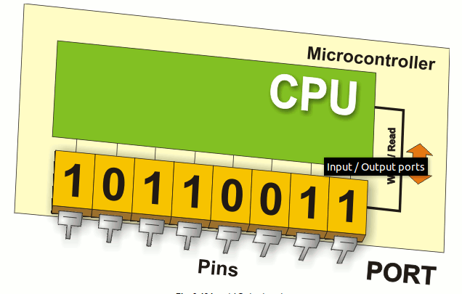
Digital I/0
www.mikroe.com/chapters/view/1
pinMode(pin, mode)
Sets pin to either INPUT or OUTPUT
digitalRead(pin)
Reads HIGH or LOW from a pin
digitalWrite(pin, value)
Writes HIGH or LOW to a pin
Electronic stuff
Output pins can provide 40 mA of current
Writing HIGH to an input pin installs a 20KΩ pullup

Slide 19
Arduino Timing
delay(ms)
Pauses for a few milliseconds
delayMicroseconds(us)
Pauses for a few microseconds
More commands: arduino.cc/en/Reference/HomePage

Slide 20
Digital? Analog?
Digital has two values: on and off
Analog has many (infinite) values
Computers don’t really do analog, they quantize
Remember the 6 analog input pins---here’s how they work
todbot.com/blog/bionicarduino

Slide 21
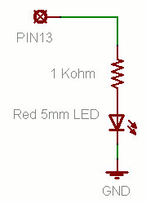
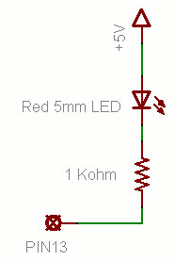
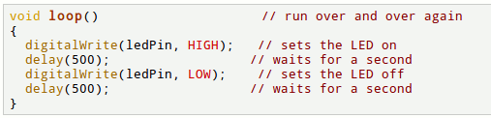
Putting It Together
Complete the sketch (program) below.
What output will be generated by this program?
What if the schematic were changed? ➔
www.ladyada.net/learn/arduino

Slide 22
How To Program Arduino
Once the circuit has been created on the breadboard, you’ll need to upload the program (known as a sketch) to the Arduino.
The sketch is a set of instructions that tells the board what functions it needs to perform.
An Arduino board can only hold and perform one sketch at a time.
The software used to create Arduino sketches is called the IDE which stands for Integrated Development Environment.

Slide 23
Arduino Programming Language
Arduino programming language can be divided in three main parts:
FUNCTIONS - For controlling the Arduino board and performing computations.
VARIABLES - Arduino data types and constants.
STRUCTURE - The elements of Arduino (C++) code.
Every Arduino sketch has two main parts to the program:
void setup() – Sets things up that have to be done once and then don’t happen again.
void loop() – Contains the instructions that get repeated over and over until the board is turned off.

Slide 24
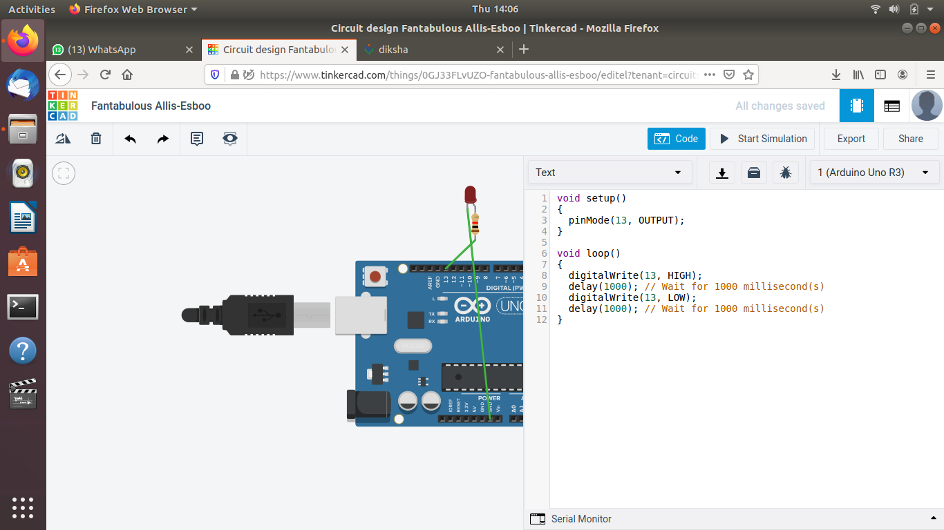

Slide 25
Serial Library
Used for communication between the Arduino board and a computer or other devices. All Arduino boards have at least one serial port (also known as a UART or USART), and some have several.
As the name implies serial communication means sending and receiving data bit by bit over a single line. Arduino uno board has one serial port at digital pins 0(RX) and 1(TX) to communicate with other external serial devices or with computer through USB cable.
The process of sending and receiving data can be observed by flashing of TX and RX LED’s on the arduino board.
The baud rate specifies how fast the data is sent over the serial line or in simple terms, the speed of serial communication. Some common rates for UART are 9600 baud, 11520 baud etc.
Serial.begin(9600) - opens the serial communication between the arduino and the computer at baud rate 9600bps.
Serial.available() - return the number of bytes that are currently present in the arduino serial buffer.
Serial.println() - this function prints data to the serial port to which arduino is connected.
Serial.read() – will read the serial data(ASCII value) from the key board

Slide 26
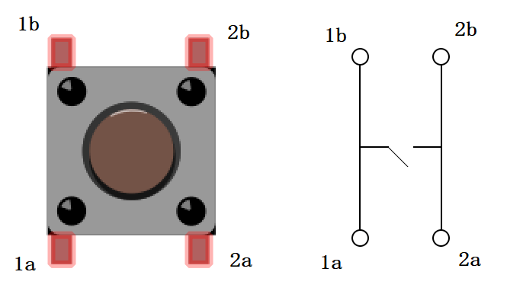
push button

Slide 27
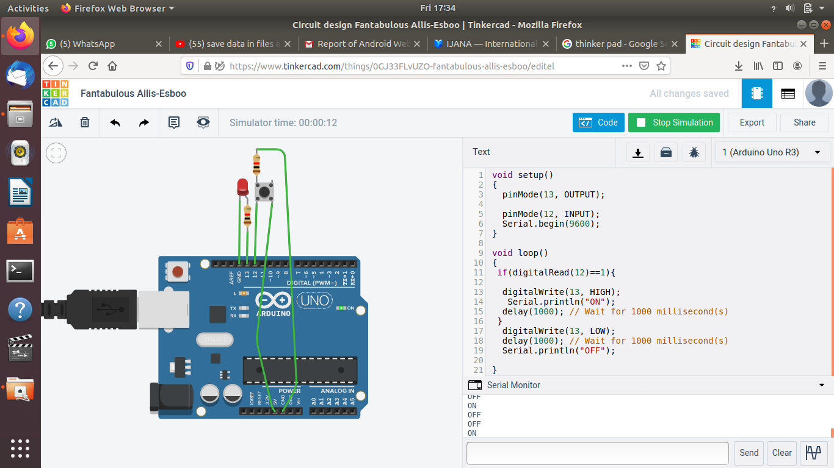

Slide 28
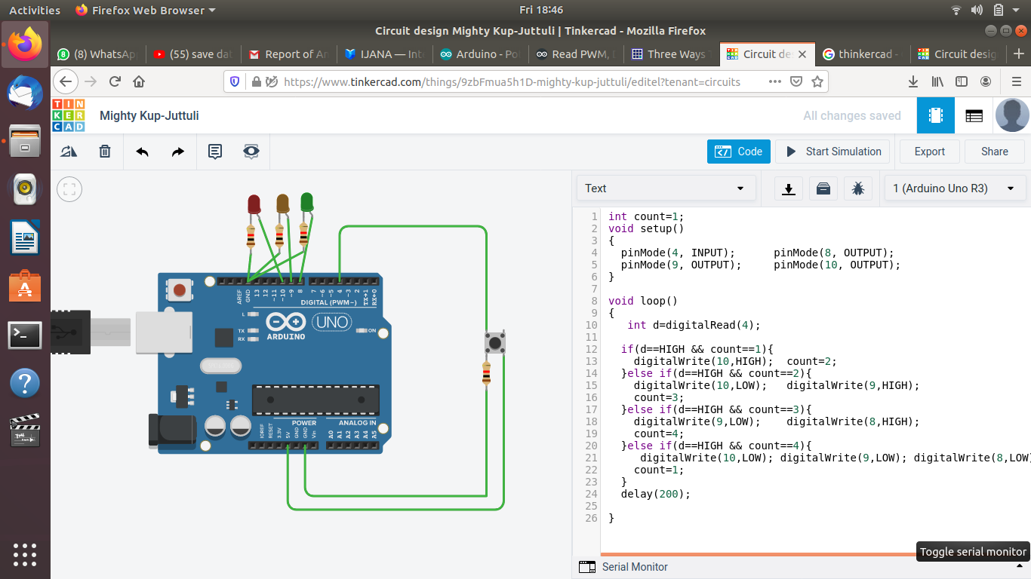
LED Rotation

Slide 29
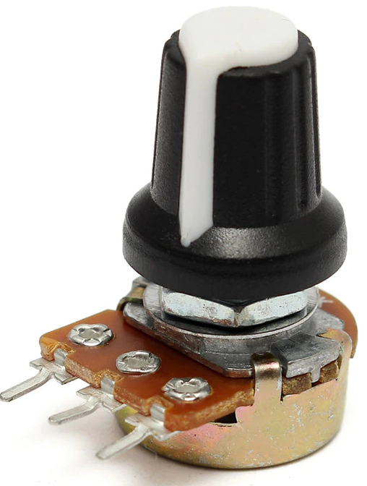
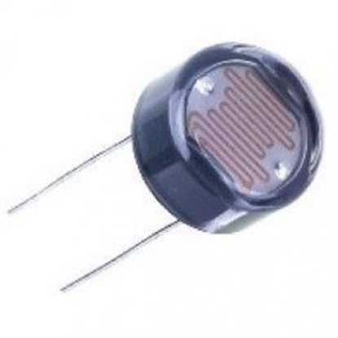
A potentiometer is a three-terminal resistor with a sliding or rotating contact that forms an adjustable voltage divider.
A variable resistor with a third adjustable terminal. The potential at the third terminal can be adjusted to give any fraction of the potential across the ends of the resistor.
An LDR (Light Dependent Resistor) is a component that has a (variable) resistance that changes with the light intensity that falls upon it. This allows them to be used in light sensing circuits.
map()
Re-maps a number from one range to another.
Arduino has an analogRead range from 0 to 1023, and an analogWrite range only from 0 to 255, therefore the data from the potentiometer needs to be converted to fit into the smaller range before using it to dim the LED.
Example:
int var=analogRead(A0);
int val=map(var,0,1024,0,256);

Slide 30
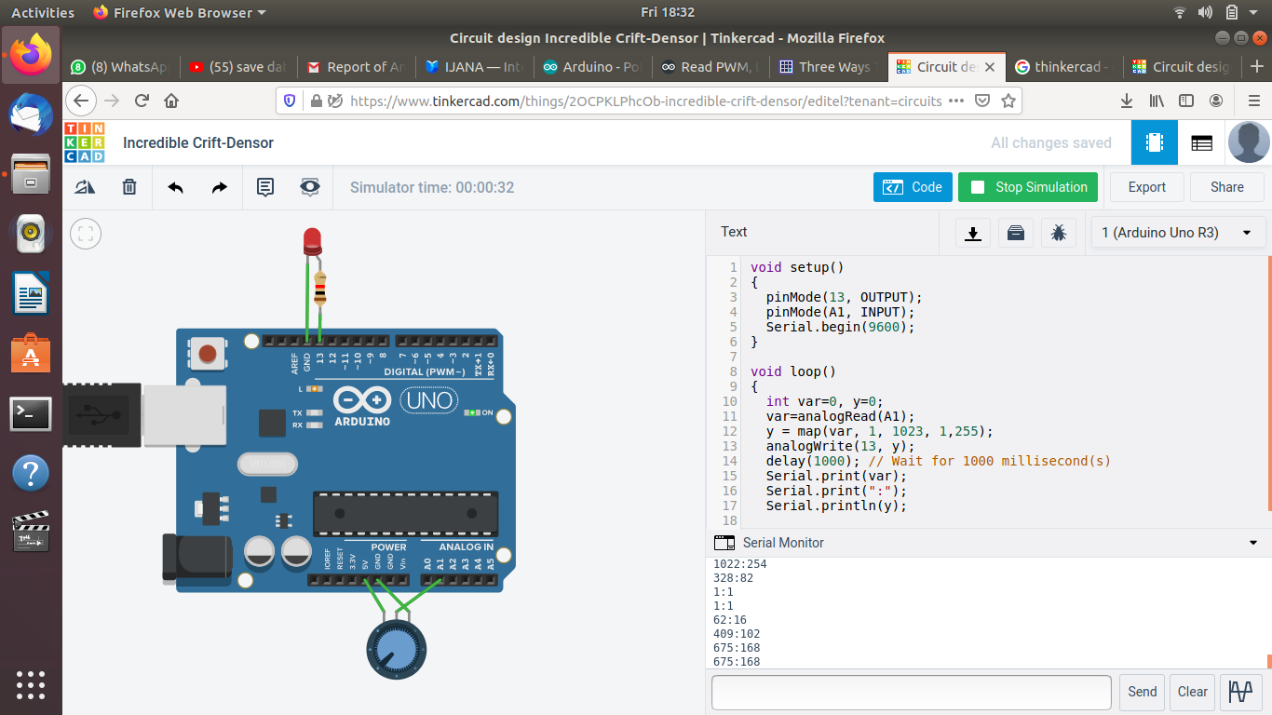

Slide 31
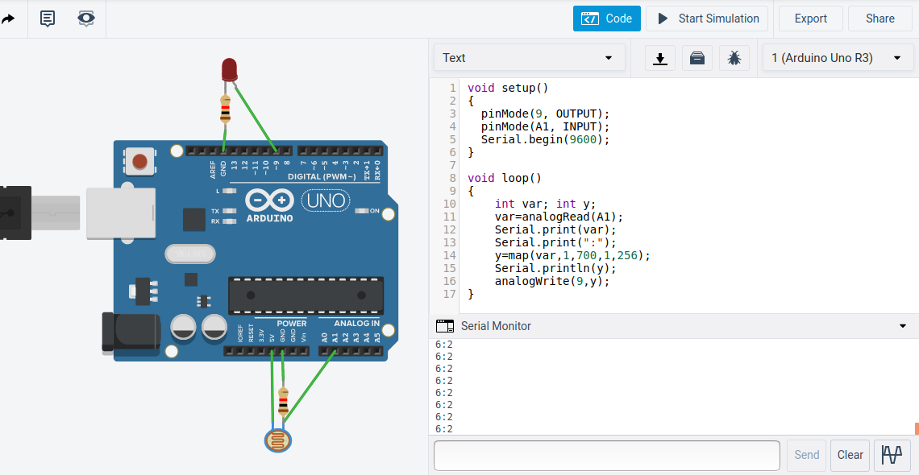

Slide 32
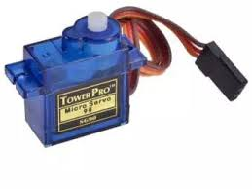
Servo Motor
A Servo Motor is a small device that has an output shaft. This shaft can be positioned to specific angular positions by sending the servo a coded signal. Usually, shaft can turn upto 180 degrees.
Servo motors were first used in the Remote Control (RC) world, usually to control the steering of RC cars or the flaps on a RC plane. With time, they found their uses in robotics, automation, and of course, the Arduino world.

Slide 33
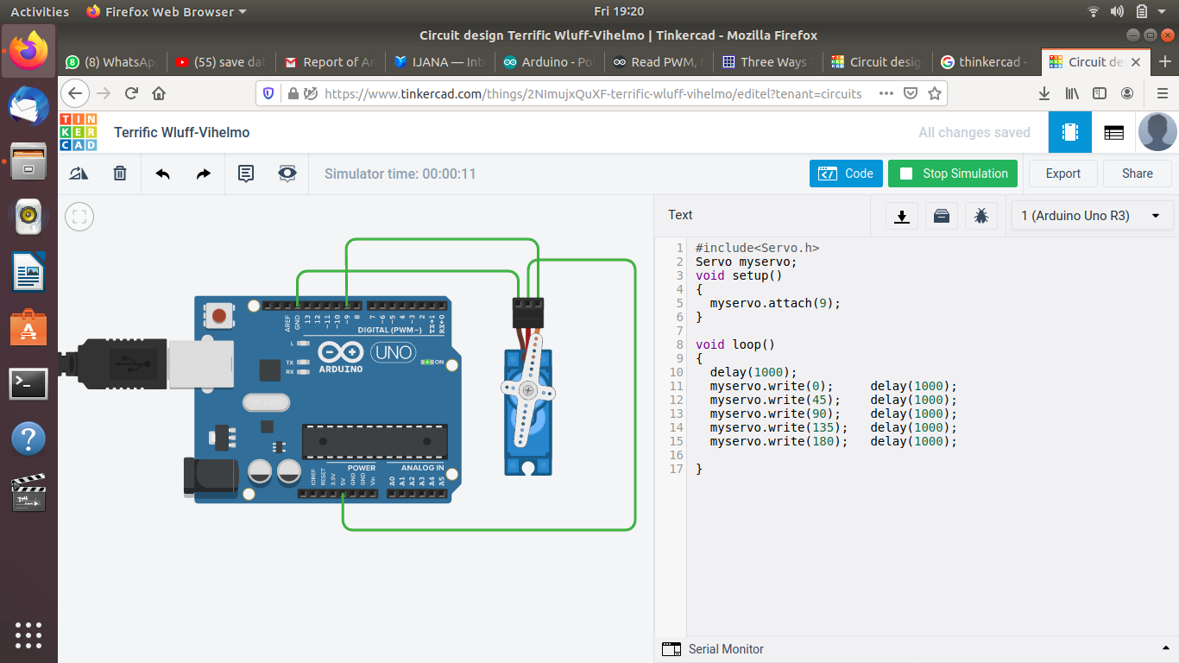

Slide 34
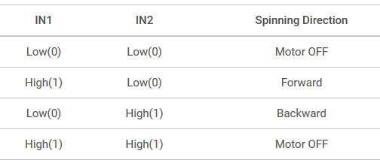
DC motors
DC motors are interfaced to Arduino using L293D Motor Driver IC. It can control both speed and spinning direction of two DC motors.
The L293D is a dual-channel H-Bridge motor driver capable of driving a pair of DC motors or one stepper motor.
https://lastminuteengineers.com/l293d-dc-motor-arduino-tutorial/

Slide 35
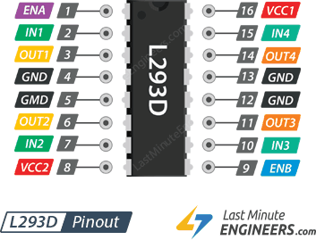
The L293D motor driver’s output channels for the motor A and B are brought out to pins OUT1,OUT2 and OUT3,OUT4 respectively.
For each of the L293D’s channels, there are two types of control pins which allow us to control speed and spinning direction of the DC motors at the same time viz. Direction control pins & Speed control pins. IN1 , IN2 & IN3 , IN4

Slide 36
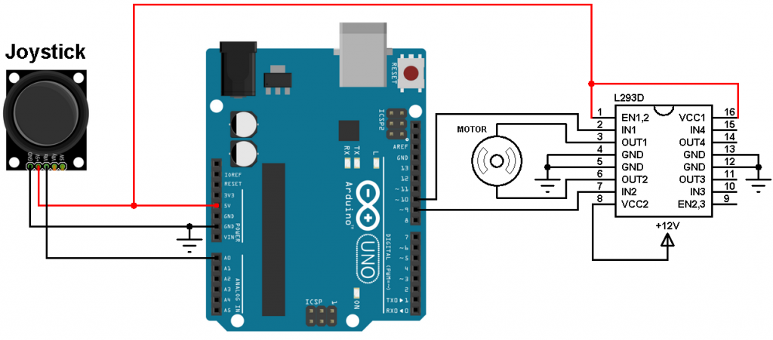

Slide 37
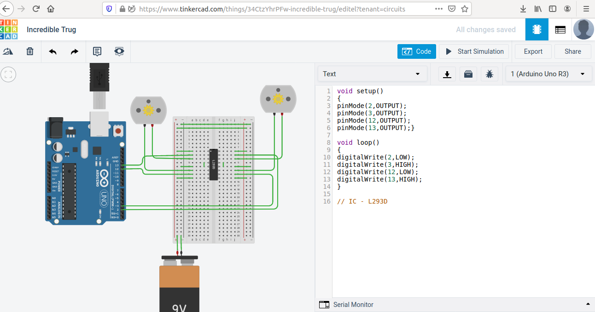

Slide 38
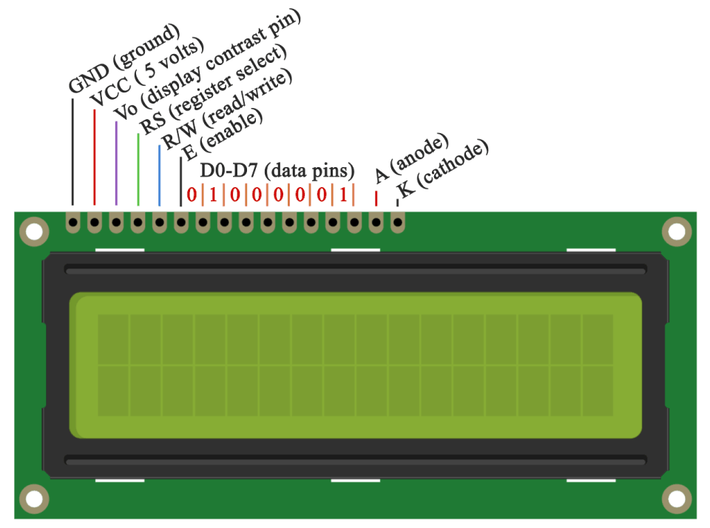
LCD – Liquid Crystal Display
The library works with in either 4- or 8-bit mode (i.e. using 4 or 8 data lines).
Vo pin on which we can attach a potentiometer for controlling the contrast of the display.
The RS pin is set on low state or zero volts, then we are sending commands to the LCD like: set the cursor to a specific location, clear the display, turn off the display and so on.
R/W pin - read/write mode
Liquid Crystal Library - #include <LiquidCrystal.h>
const int rs = 12, en = 11, d4 = 5, d5 = 4, d6 = 3, d7 = 2;
LiquidCrystal lcd(rs, en, d4, d5, d6, d7);
lcd.begin()
lcd.print()
lcd.setCursor()
lcd.noDisplay();
lcd.display();

Slide 39
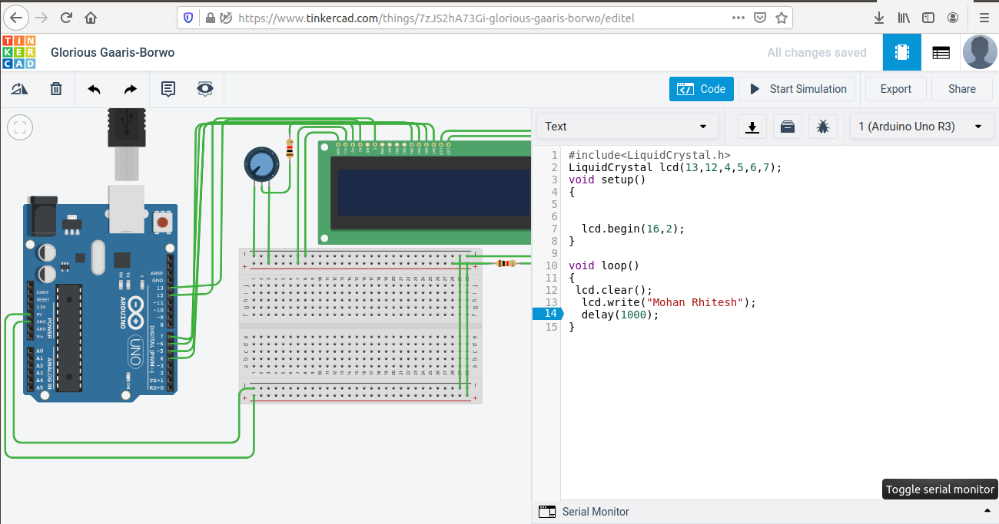

Slide 40
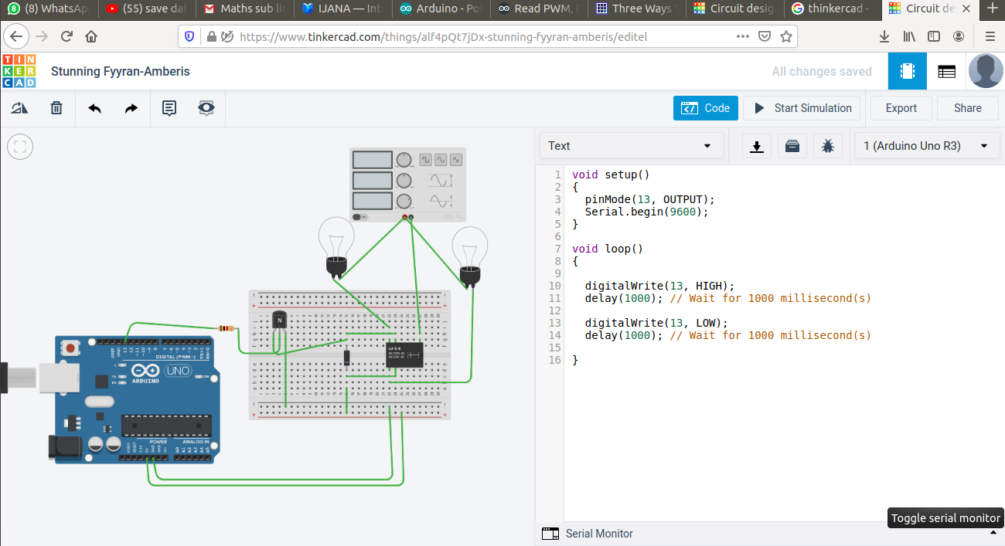

Slide 41
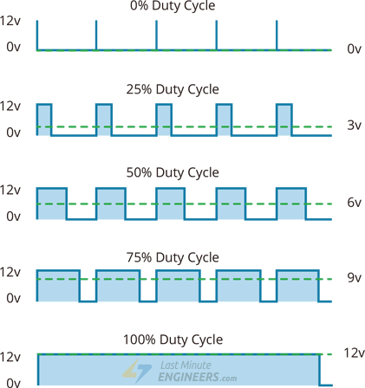
PWM - Pulse Width Modulation
PWM is a technique where average value of the input voltage is adjusted by sending a series of ON-OFF pulses.
The average voltage is proportional to the width of the pulses known as Duty Cycle.
The higher the duty cycle, the greater the average voltage being applied to the dc motor(High Speed) and the lower the duty cycle, the less the average voltage being applied to the dc motor(Low Speed).
Below image illustrates PWM technique with various duty cycles and average voltages.

